Slide 1

Scrum meeting 24/10/24
Scrum master: David

Slide 2
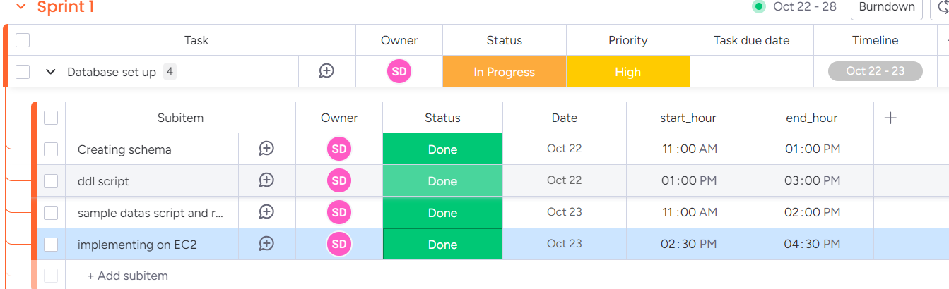
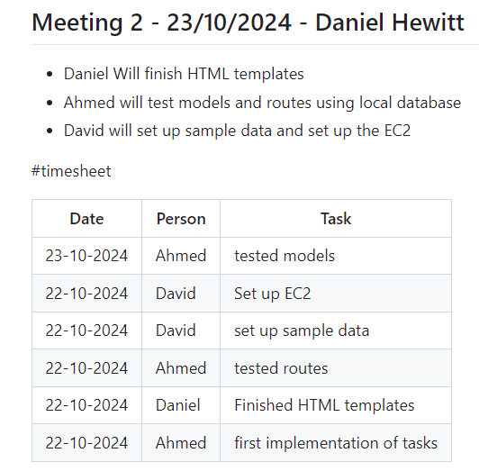
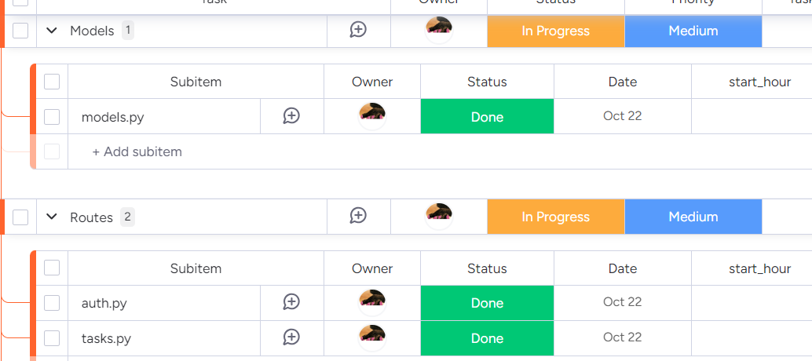
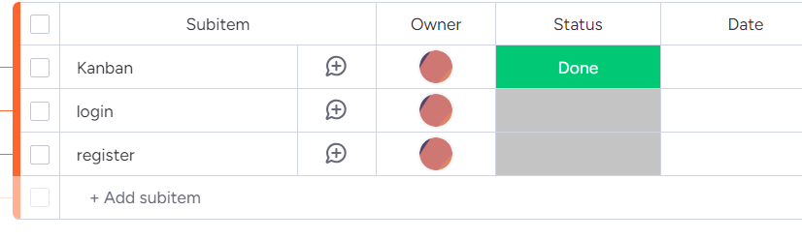
What was worked on

Slide 3

Plan for Today
Daniel: finish off the css template, kanban
Ahmed: Further debuging, further optimazition
David: fixing EC2 docker MySQL data storage, optimize DB for addtional tasks.

Slide 4

Product owner feedback
-

